Slide 1

Healthcare Analytics In-Hospital Mortality Prediction
Presented by Group 1
Quang Nguyen, Sai Susmitha Vanarasa,
Mounika Loka, Aleena Alex Almeida

Slide 2

Content
Introduction
Methodology
Importing Libraries, Dataset
Exploratory Data Analysis
Data Processing
Modelling
Results
Conclusion
Q & A

Slide 3

Introduction
The healthcare sector is one of the most important domains that impacts the entire global population and is closely linked to the development of any country.
There are many studies for Health care maintenance or improvement.
One of these studies is in hospital mortality prediction. The hospital standardized mortality ratio (HSMR) is an important measure to improve patient safety and quality of care in Canadian hospitals.

Slide 4

Objectives
The predictors of in-hospital mortality for intensive care units (ICU) admitted heart failure patients remain poorly characterized.
We aimed to develop and validate a prediction model for all-cause in-hospital mortality among ICU admitted Heart Failure patients.

Slide 5
Methodology
Importing Libraries, Dataset
Exploratory Data Analysis
Data Processing
Modelling
Evaluation

Slide 6

Importing Libraries, Dataset
Libraries:
Xgboost
Imblearn
Graphviz
Data: https://www.kaggle.com/datasets/saurabhshahane/in-hospital-mortality-prediction

Slide 7

Exploratory Data Analysis
Which age group is most in the hospital?
Which age group of patients dies more in the hospital?
Which gender is the most prevalent in the hospital?
What is the rate of non-survived patients with diabetes?
What is the rate of non-survived patients with hypertension?
How many patients in the hospital have depression?
How many patients Alive in the hospital they are with renal failure?
How many patients Alive in the hospital they are with Anemia?

Slide 8
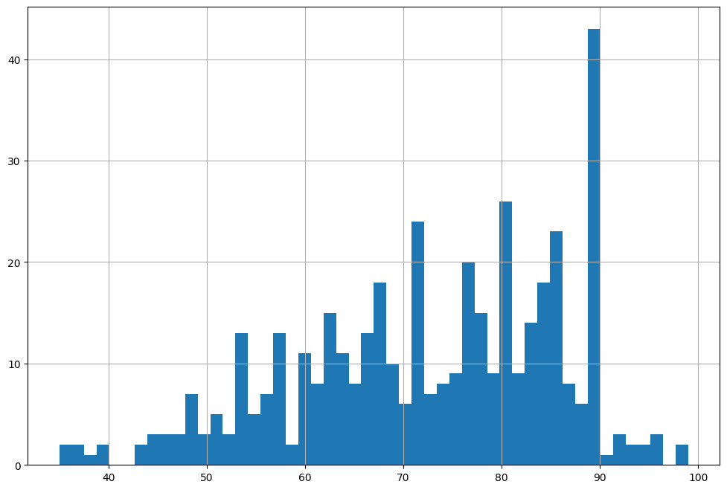
Which age group is most in the hospital?

Slide 9
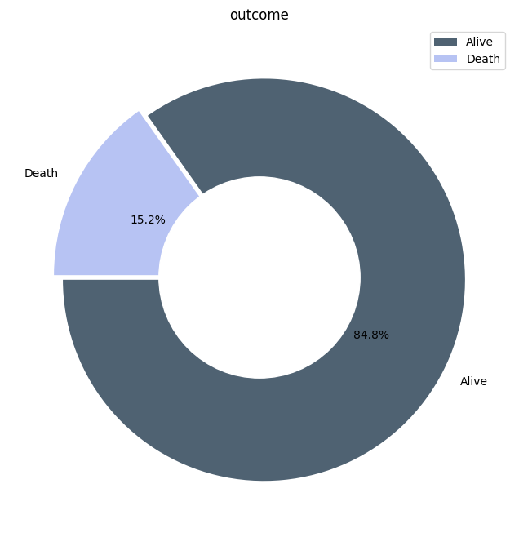
Which age group of patients dies more in the hospital?

Slide 10
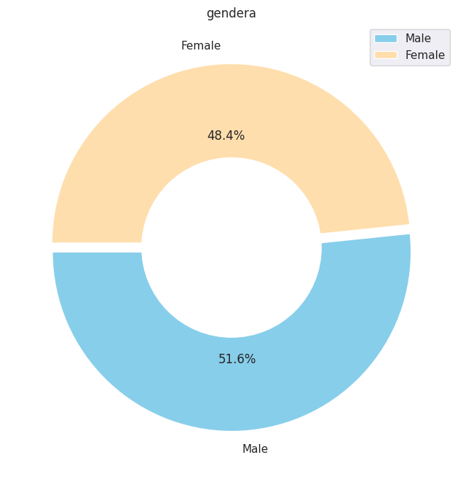
Which gender is the most prevalent in the hospital?

Slide 11
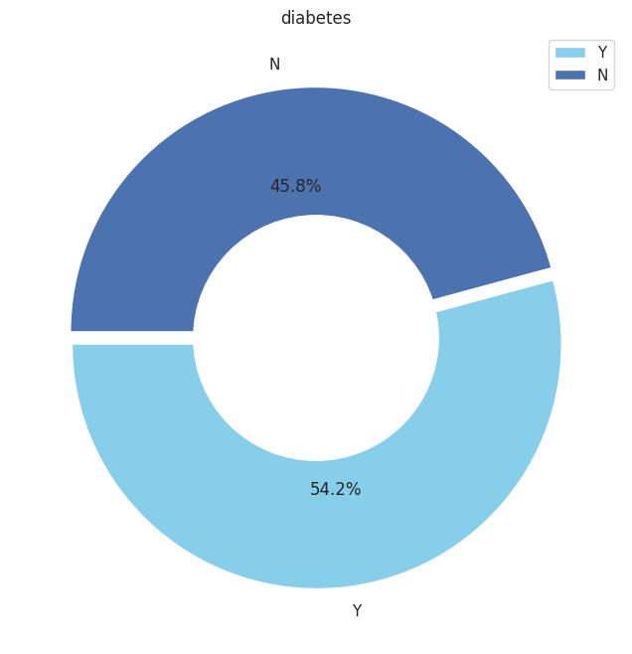
What is the rate of non-survived patients with diabetes?

Slide 12
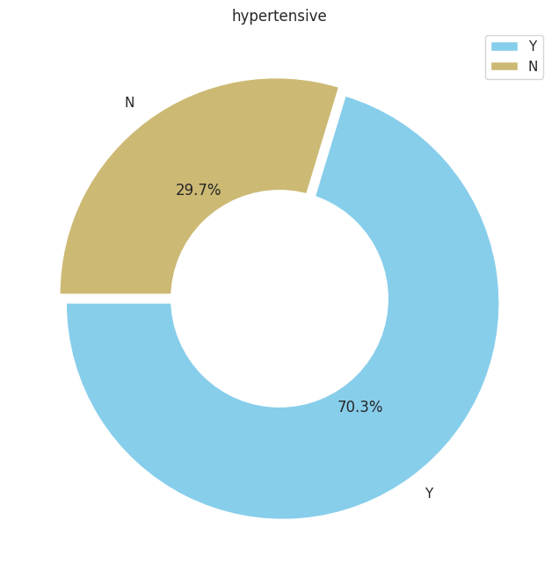
What is the rate of non-survived patients with hypertension?

Slide 13
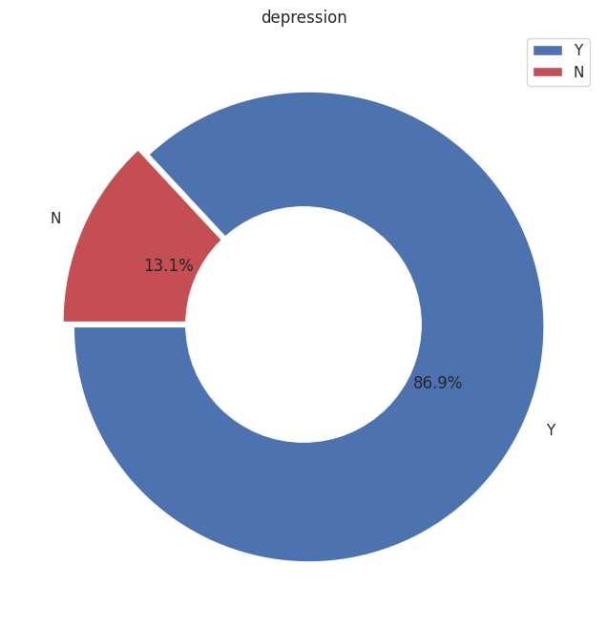
How many patients in the hospital have depression?

Slide 14
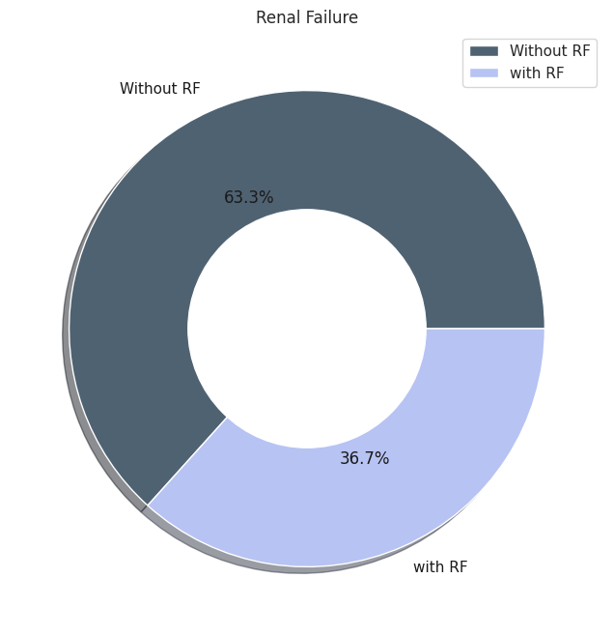
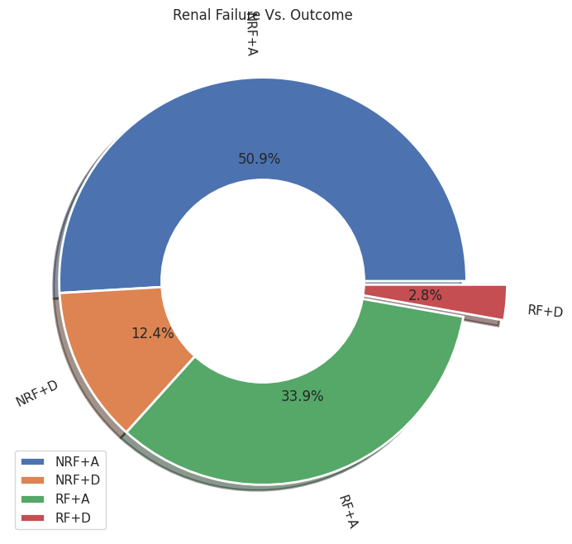
How many patients Alive in the hospital they are with renal failure?

Slide 15
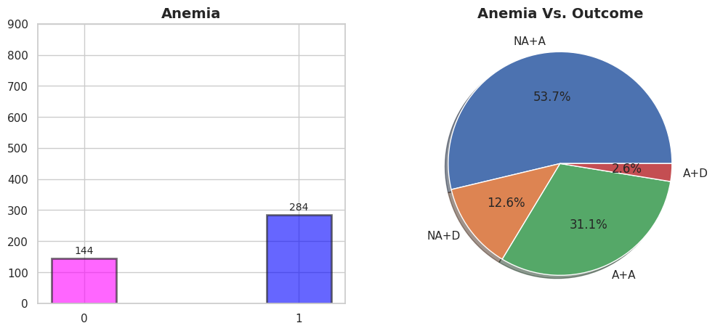
How many patients Alive in the hospital they are with Anemia?

Slide 16
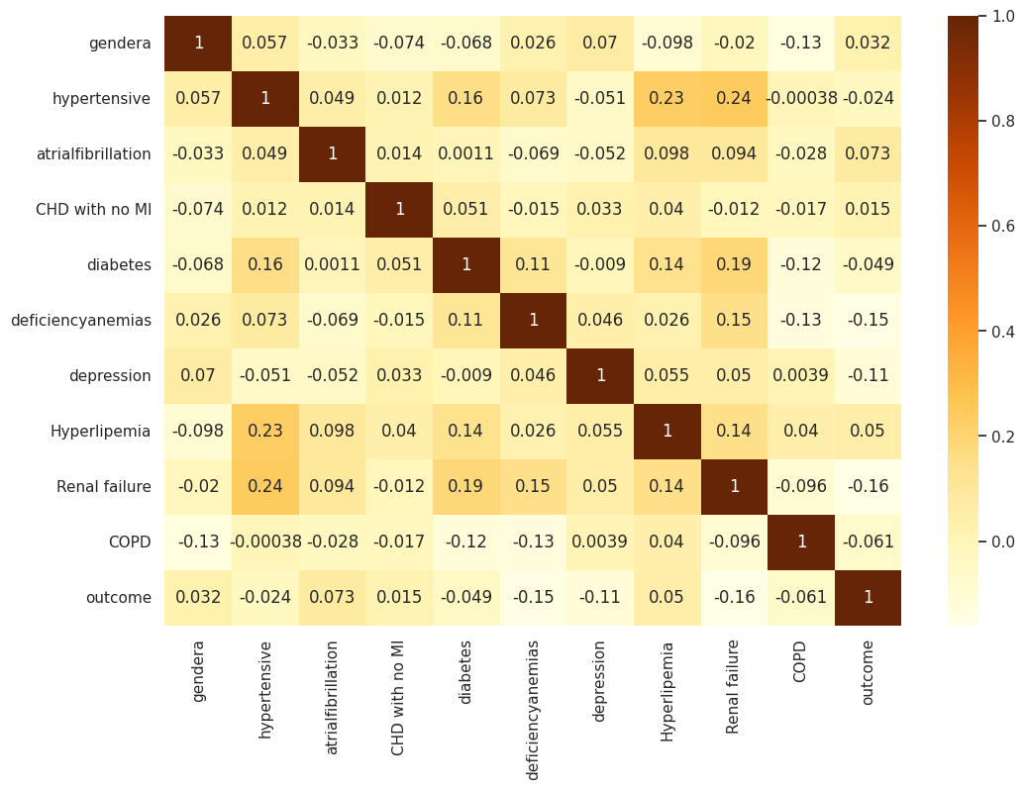
Correlation

Slide 17
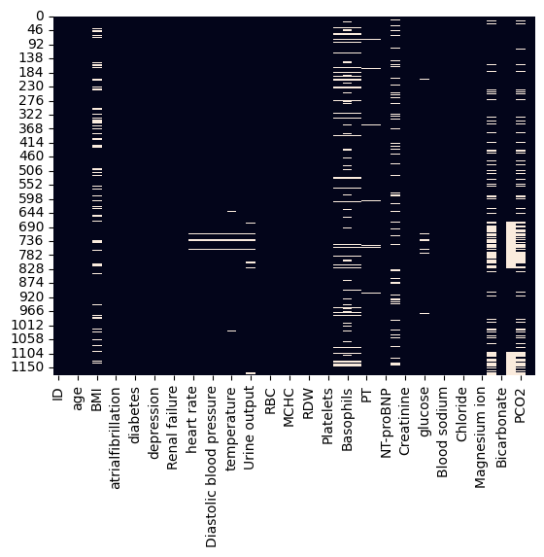
Data Processing
Heatmap with NULL values

Slide 18

Data Processing
The original shape of dataset is (1177, 51)
Drop Group column because it has no meaning
We decided to drop all rows with nulls
df = df.dropna(how='any',axis=0)
After dropping, the shape of dataset is (428, 50)

Slide 19

Modelling
First try with xgboost
SMOTE
Second try with xgboost after SMOTE
Random Forest
Logistic Regression
SVM
KNN

Slide 20
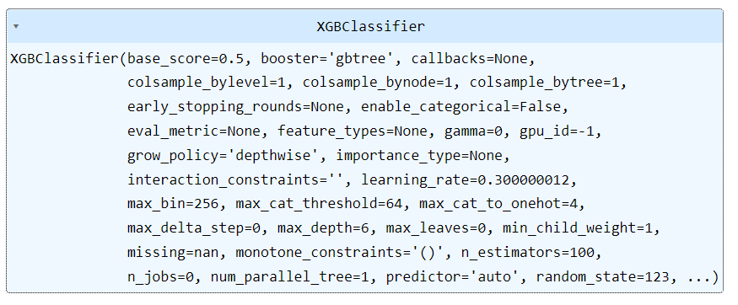
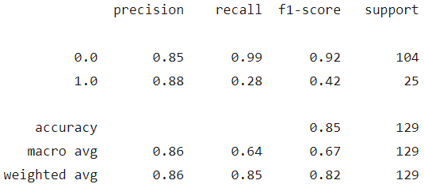
First try with xgboost

Slide 21
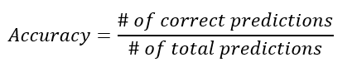
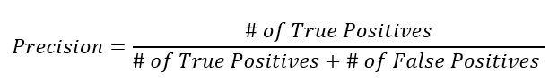
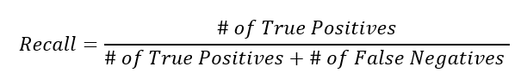
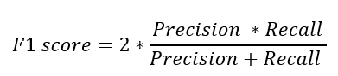
A bit on Maths

Slide 22
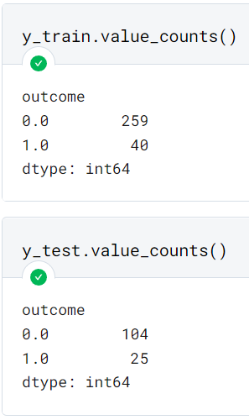
Data Imbalance Issue
The percentage of live patients is always larger then the percentage of died patients.
Due to this imbalance, the model tends to predict patients to be alive.
Solution is to balance data between majority class (live) and minority (died) by using SMOTE technique

Slide 23
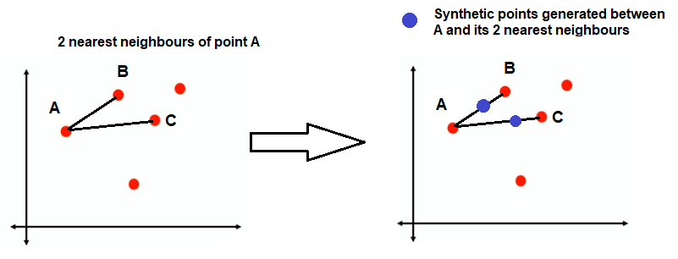
Synthetic Minority Oversampling Technique
After dropping nulls and before SMOTE, the shape is (428, 50)
After SMOTE, the shape is (726, 50)

Slide 24
All modeling after SMOTE
Machine Learning Model | Precision | Recall
KNN | 0.77 | 0.77
SVM | 0.81 | 0.81
Logistic Regression | 0.81 | 0.81
Random Forest | 0.93 | 0.93
XGBoost | 0.95 | 0.95

Slide 25

Evaluation
Classification Report
Precision
Recall
F1-score
Support
Receiver Operating Characteristics (ROC) Curve

Slide 26
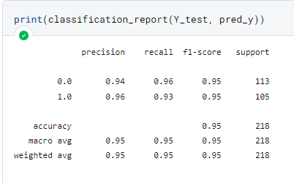
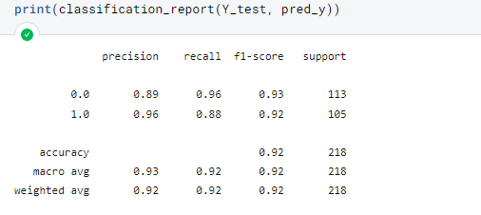
XGBoost Random Forest

Slide 27
Results
From the table, we can see that XGBoost has achieved the highest accuracy on train and test data with 95%.
Random Forest classifier is the second-best machine learning model with 93% accuracy on test data.
Machine Learning Model | Precision | Recall
KNN | 0.77 | 0.77
SVM | 0.81 | 0.81
Logistic Regression | 0.81 | 0.81
Random Forest | 0.93 | 0.93
XGBoost | 0.95 | 0.95

Slide 28
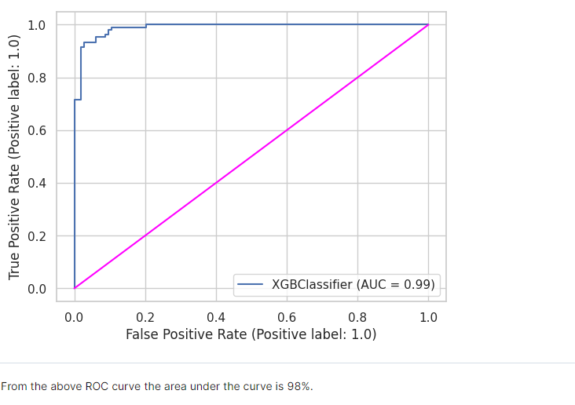
ROC curve: ROC stands for receiver operating characteristic and the graph is plotted against TPR and FPR for various threshold values. As TPR increases FPR also increases.

Slide 29

Conclusion
XGBoost which got highest accuracy of 95% is the best model, which is suitable to predict the mortality of heart failure patients who are admitted in ICU.

Slide 30

Q & A

